Slide 1
Thesis Outline and ^{DRDC} Dielectric powder Imaging
Yutong Zhao
March 3rd 2018

Slide 2
Thesis Outline(1)
Abstract (0%)
Introduction (90%)
Theory (70%)
Experiment Methods (20%)
Experiment Results (20%)
Conclusion (0%)
Future Work (0%)

Slide 3
Thesis Outline(2)
Introduction
Light-matter interaction
Active resonator & magnetic material
1.1 Ferromagnetic Resonance and Magnon
1.2 Microwave cavity and Cavity Photon
1.3 Emergence of Cavity Magnon Polaritons

Slide 4
Thesis Outline(3)
Theory
2.1 Cavity mode
2.1.1 RLC circuit model
2.1.2 Classical Oscillator
2.1.3 Quantum Harmonic Oscillator
2.2 Magnon
2.2.1 Ferromagnetic Resonance
2.2.2 Collective Spin Hamiltonian
2.2.3 Heisenberg model for magnon
2.3 Cavity Magnon Polaritons
2.3.1 Coupled Oscillator
2.3.2 Quantum Hamiltonian
2.3.3 Magnon Quintuplet

Slide 5
Thesis Outline(4)
Experiment Methods
3.1 Cavity Design
3.1.1 Microstrip cavity
3.1.2 Feedback cavity
3.2 Experiment Setup
Overall setup
3.2.1 Electromagnet
3.2.2 Vector Network Analyser
3.2.3 Power supply
3.2.4 3-D stage

Slide 6
Thesis Outline(5)
Experiment Results
4.1 Magnetically Induced Transparency
4.1.1
4.1.2
4.1.3
4.2 Strong coupling
4.2.1
4.2.2
4.2.3
4.3 Magnon quintuplet
4.3.1
4.3.2
4.3.3
4.4 TBD

Slide 7
Thesis Outline(3)
Conclusion
Future Work

Slide 8
Timeline
Finish the Thesis
Start prepare presentation
Third practise
Perform presentation
& submit honor thesis
First practise
modify thesis and presentation
2018
March
April
March 9
March 16
March 19
March 26
April 2
April 9
Second practise
& Modify
Finish presentation
Finish additional experiments

Slide 9
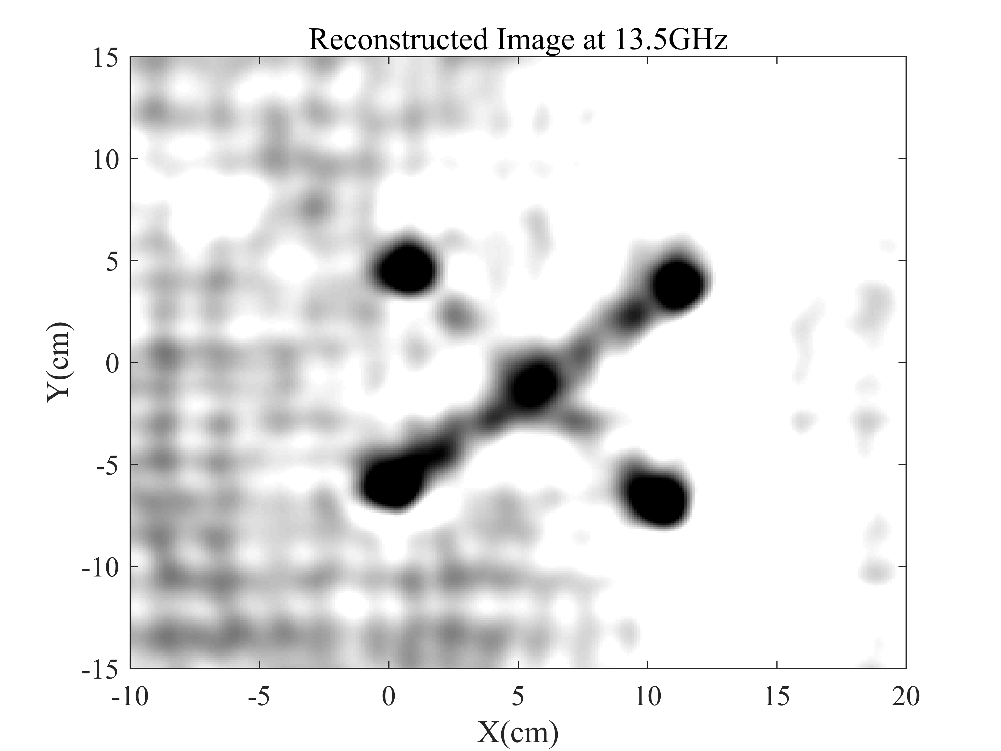
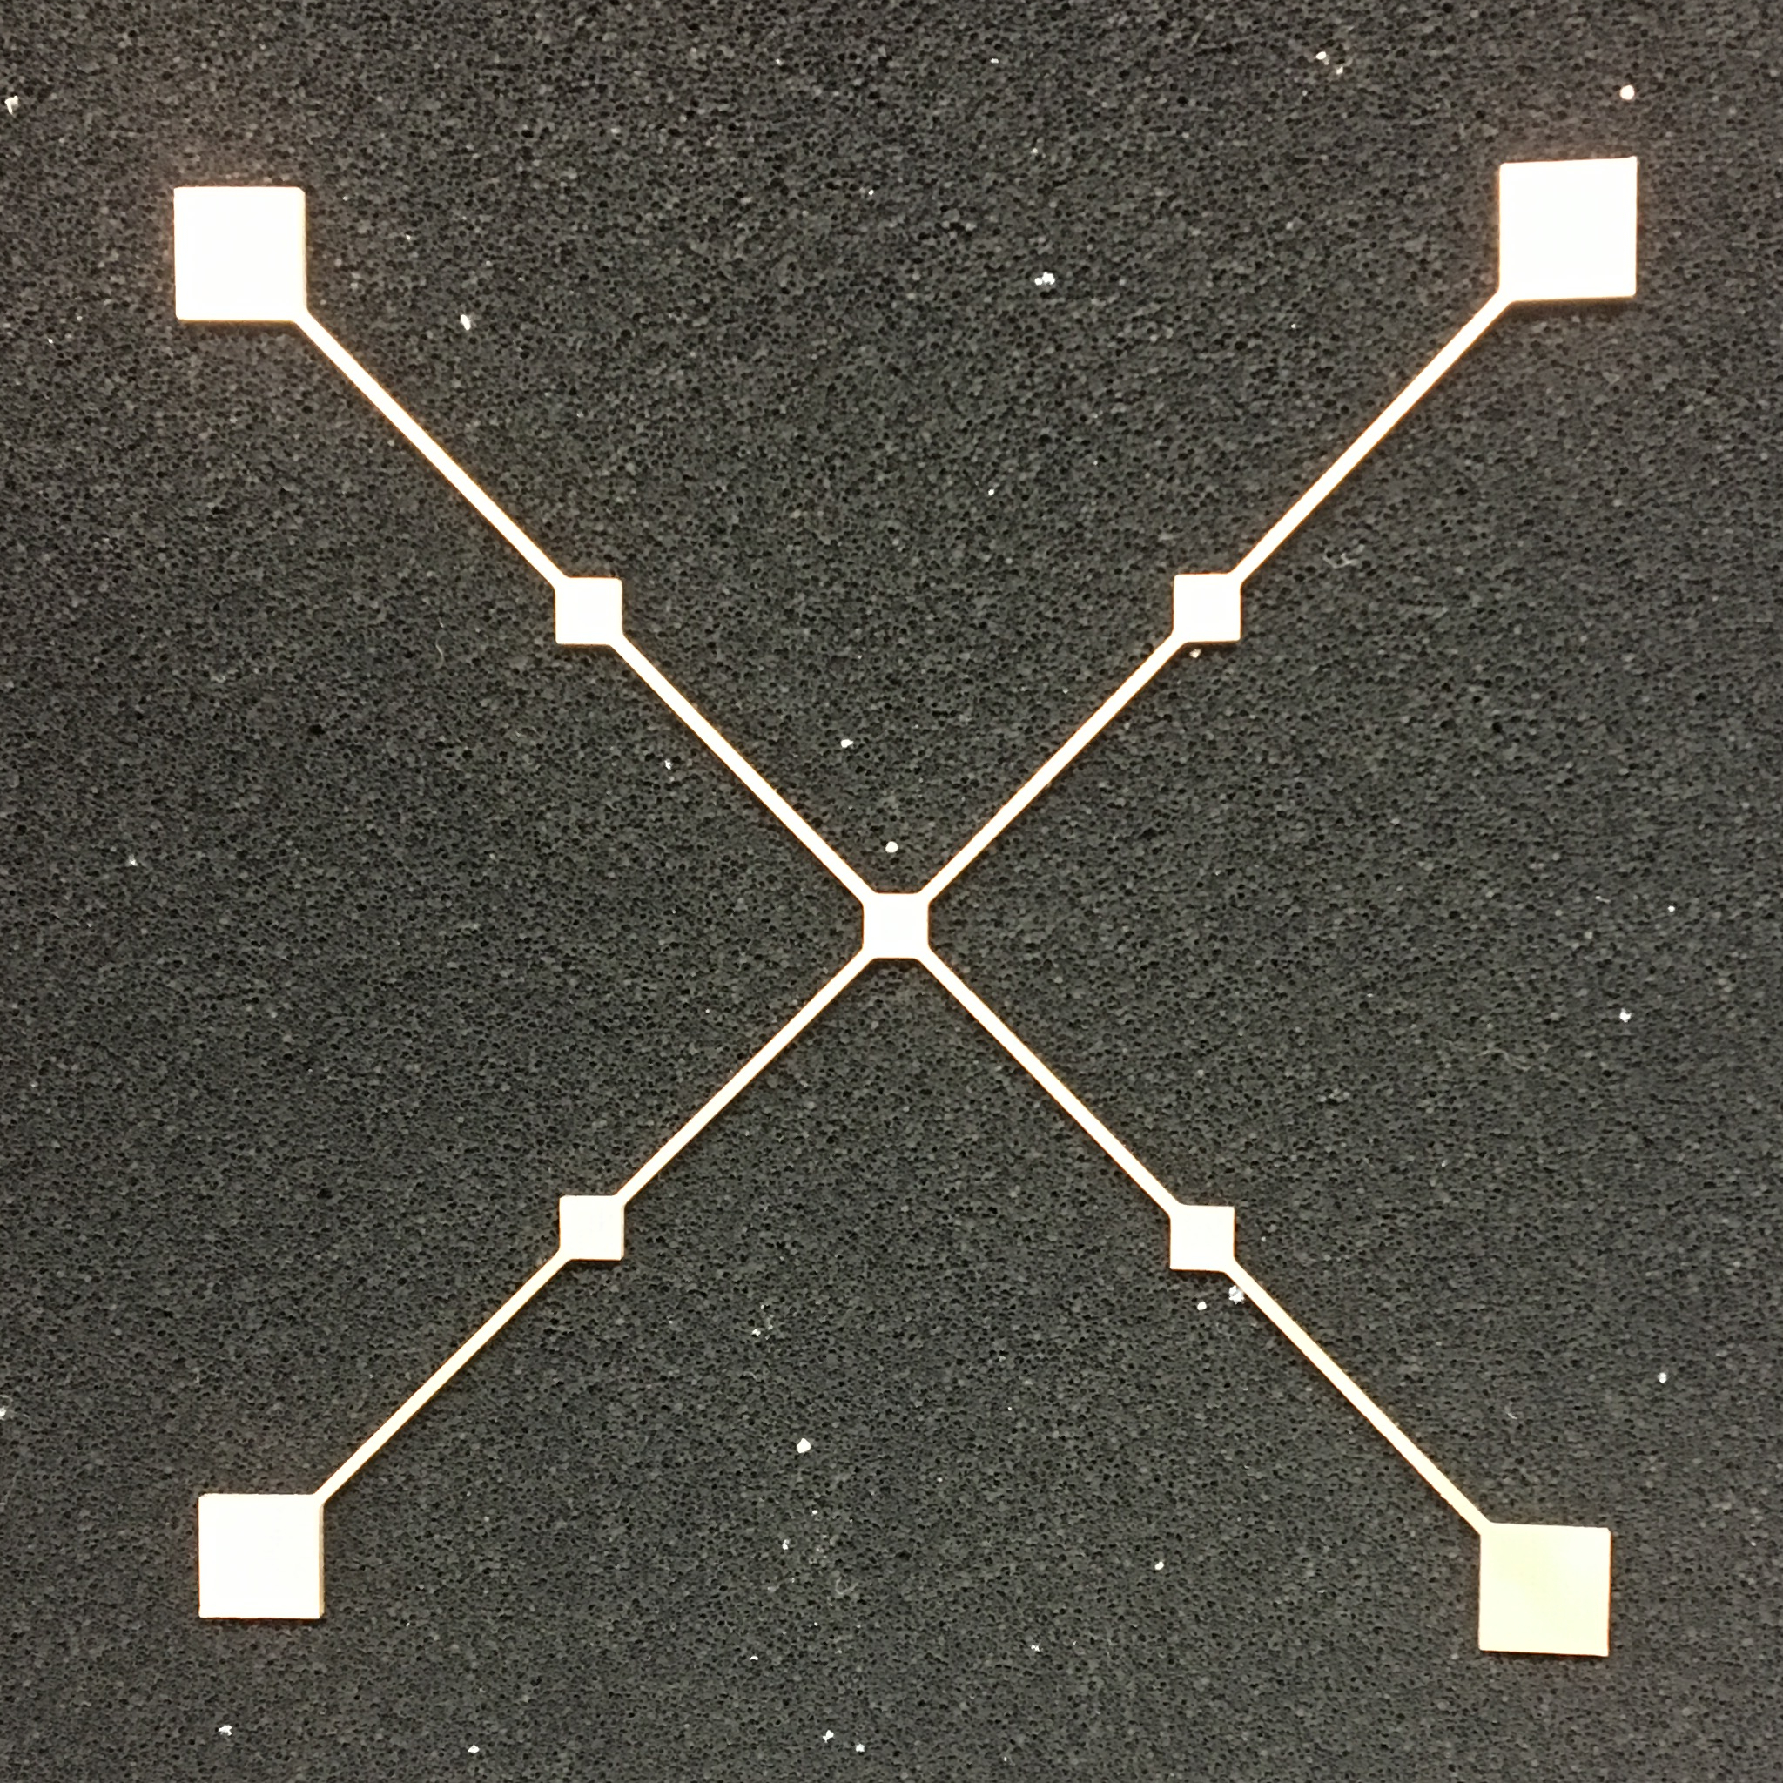
Imaging Results(1)

Slide 10
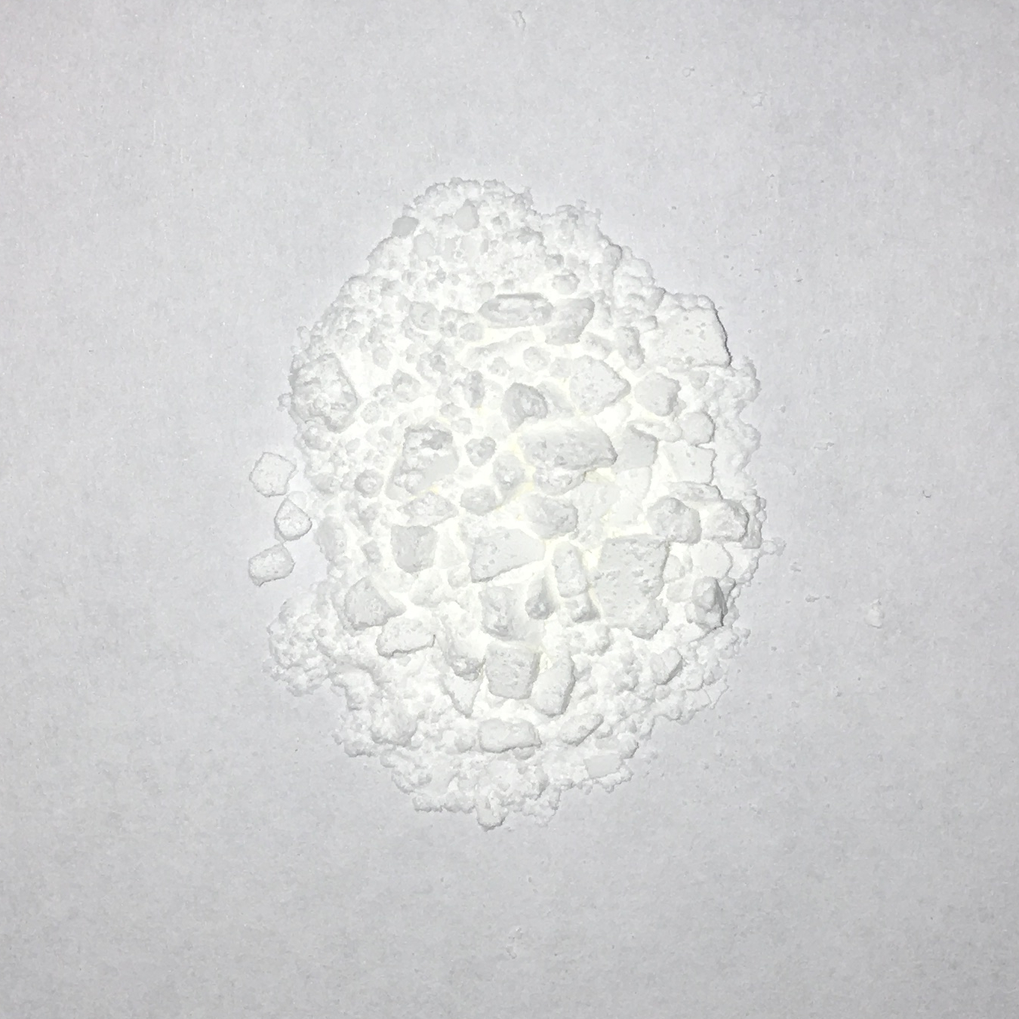
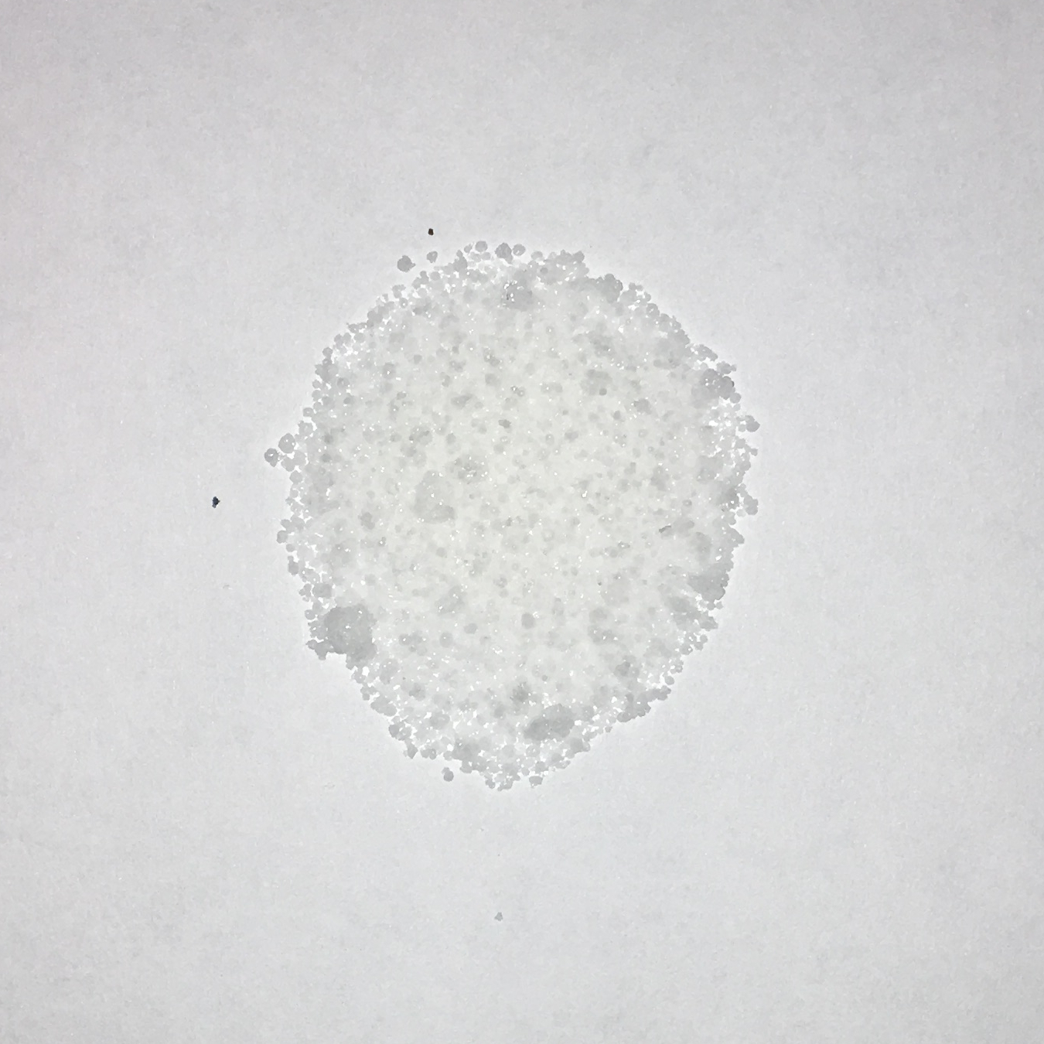
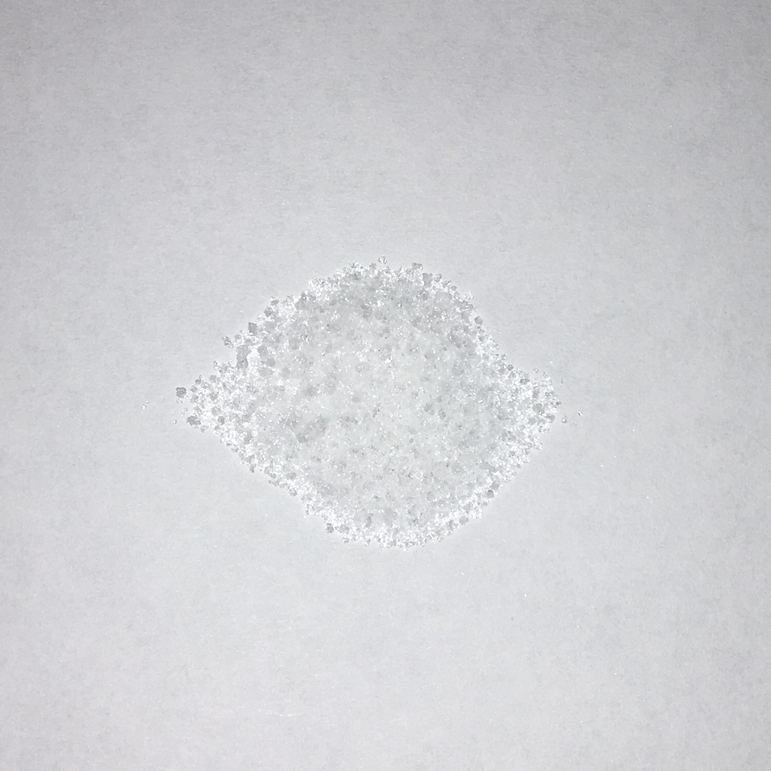
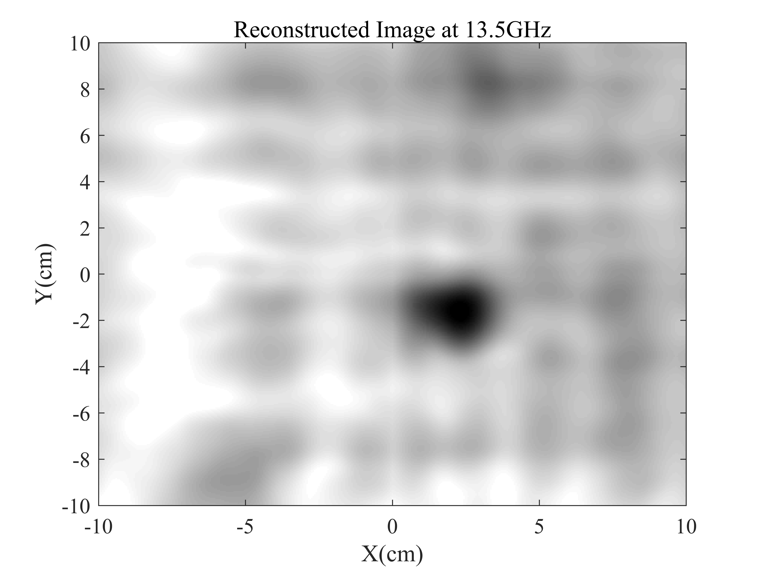
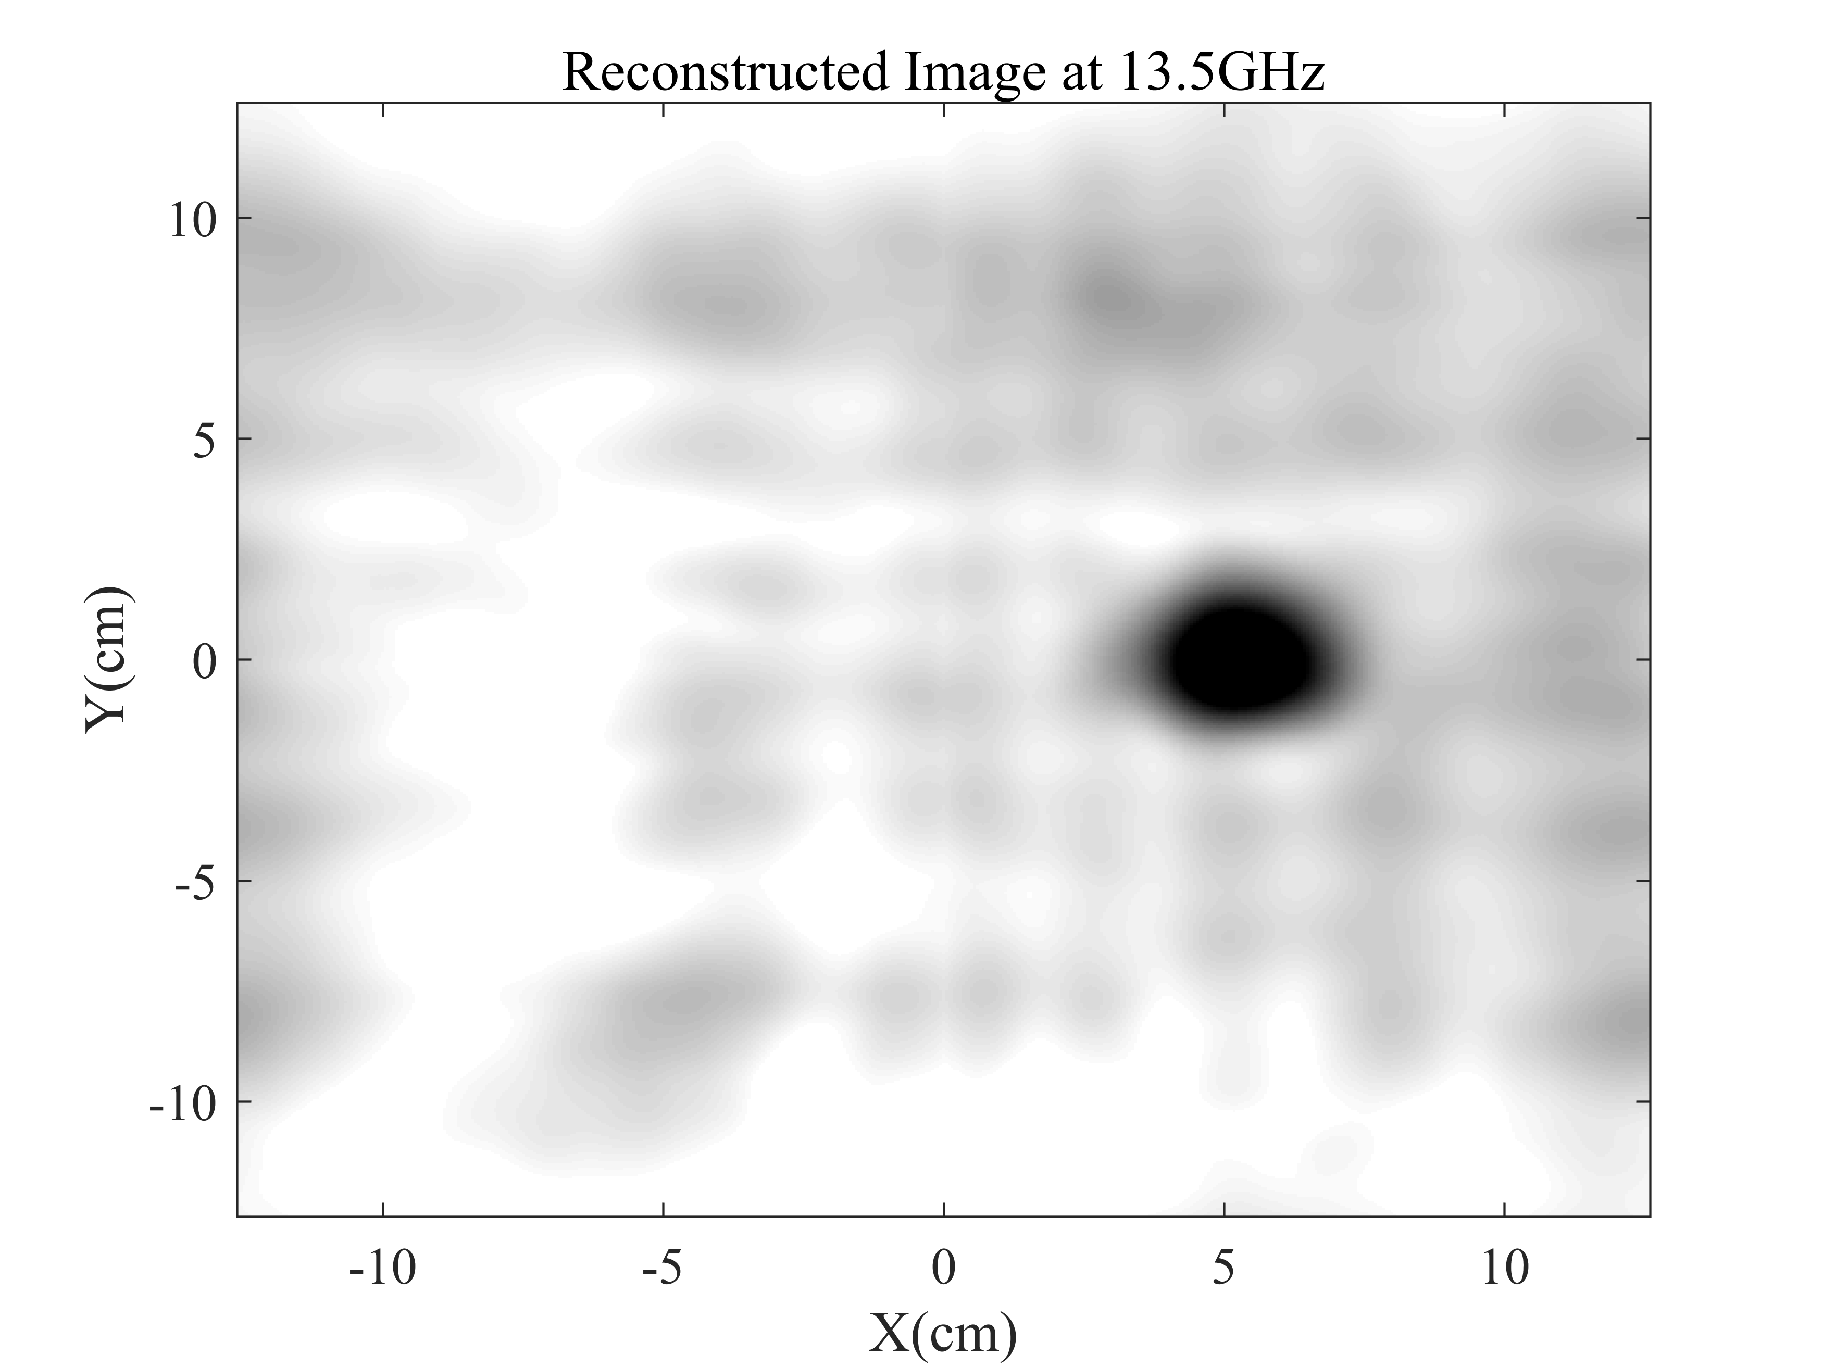
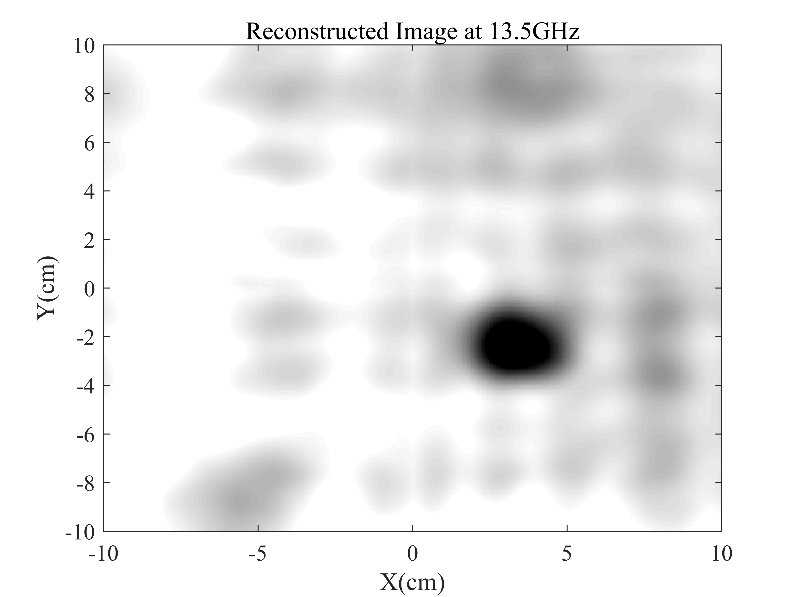
Imaging Results(2)
Icing sugar
NH₄NO₃
KClO₃

Slide 11
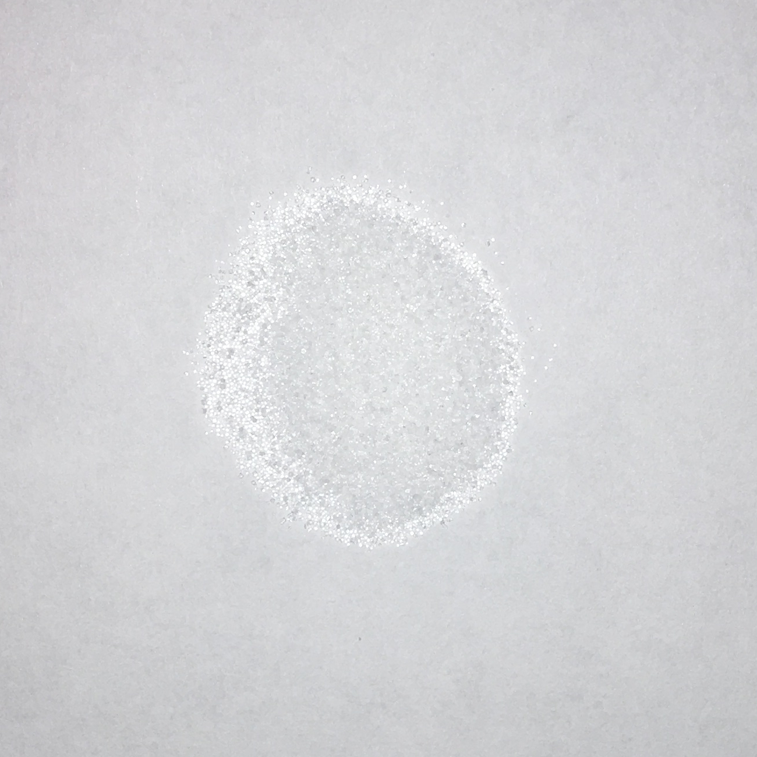
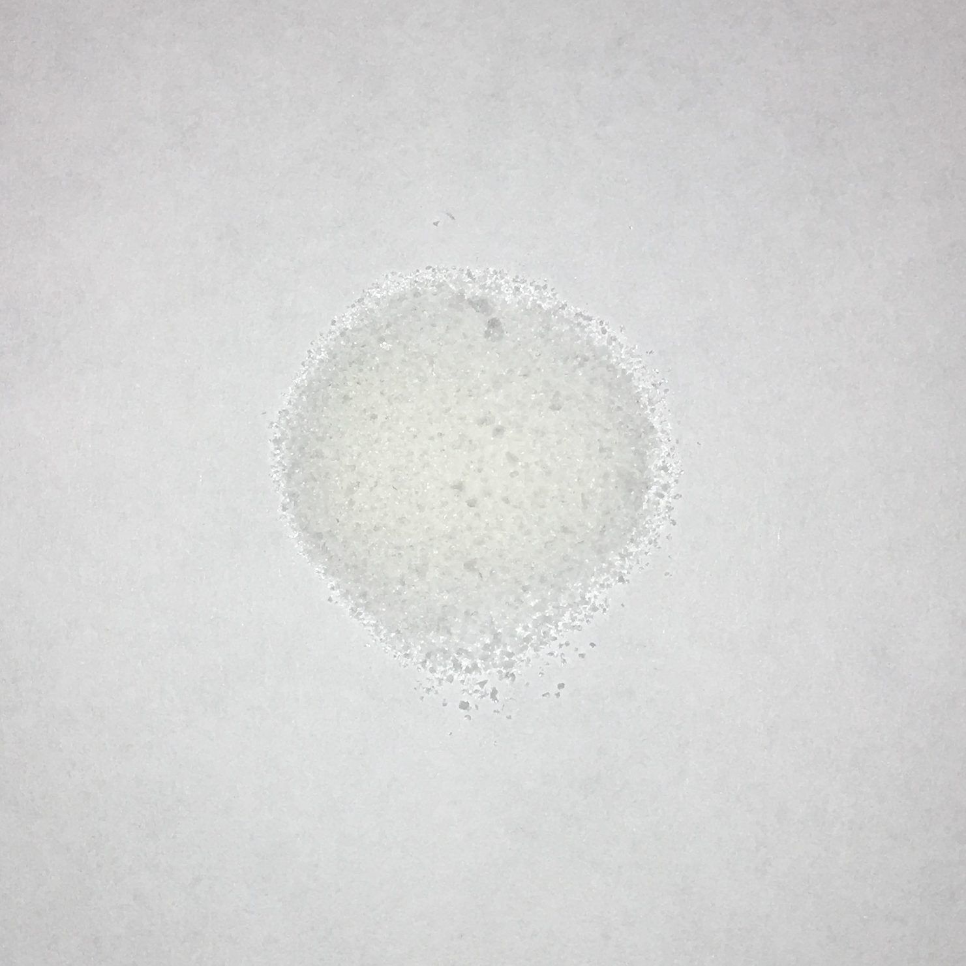
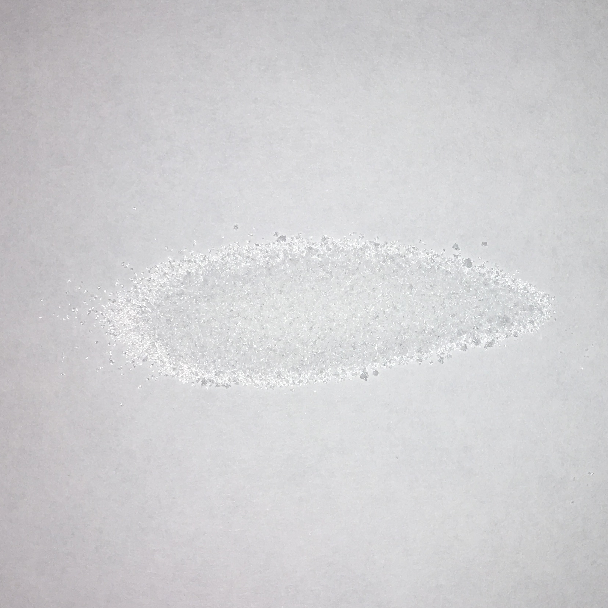
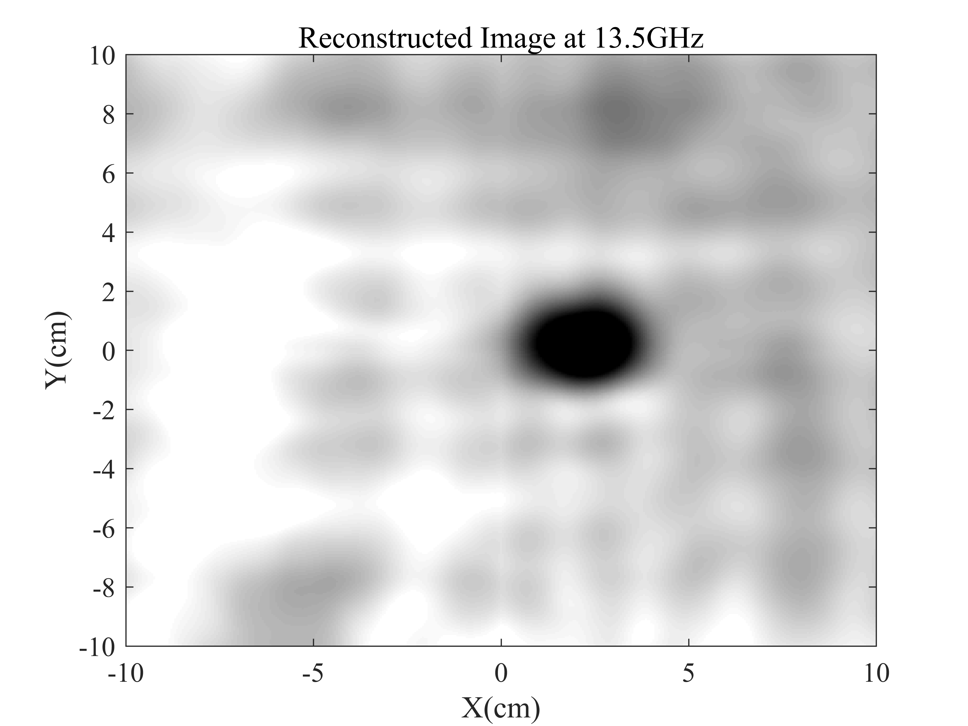
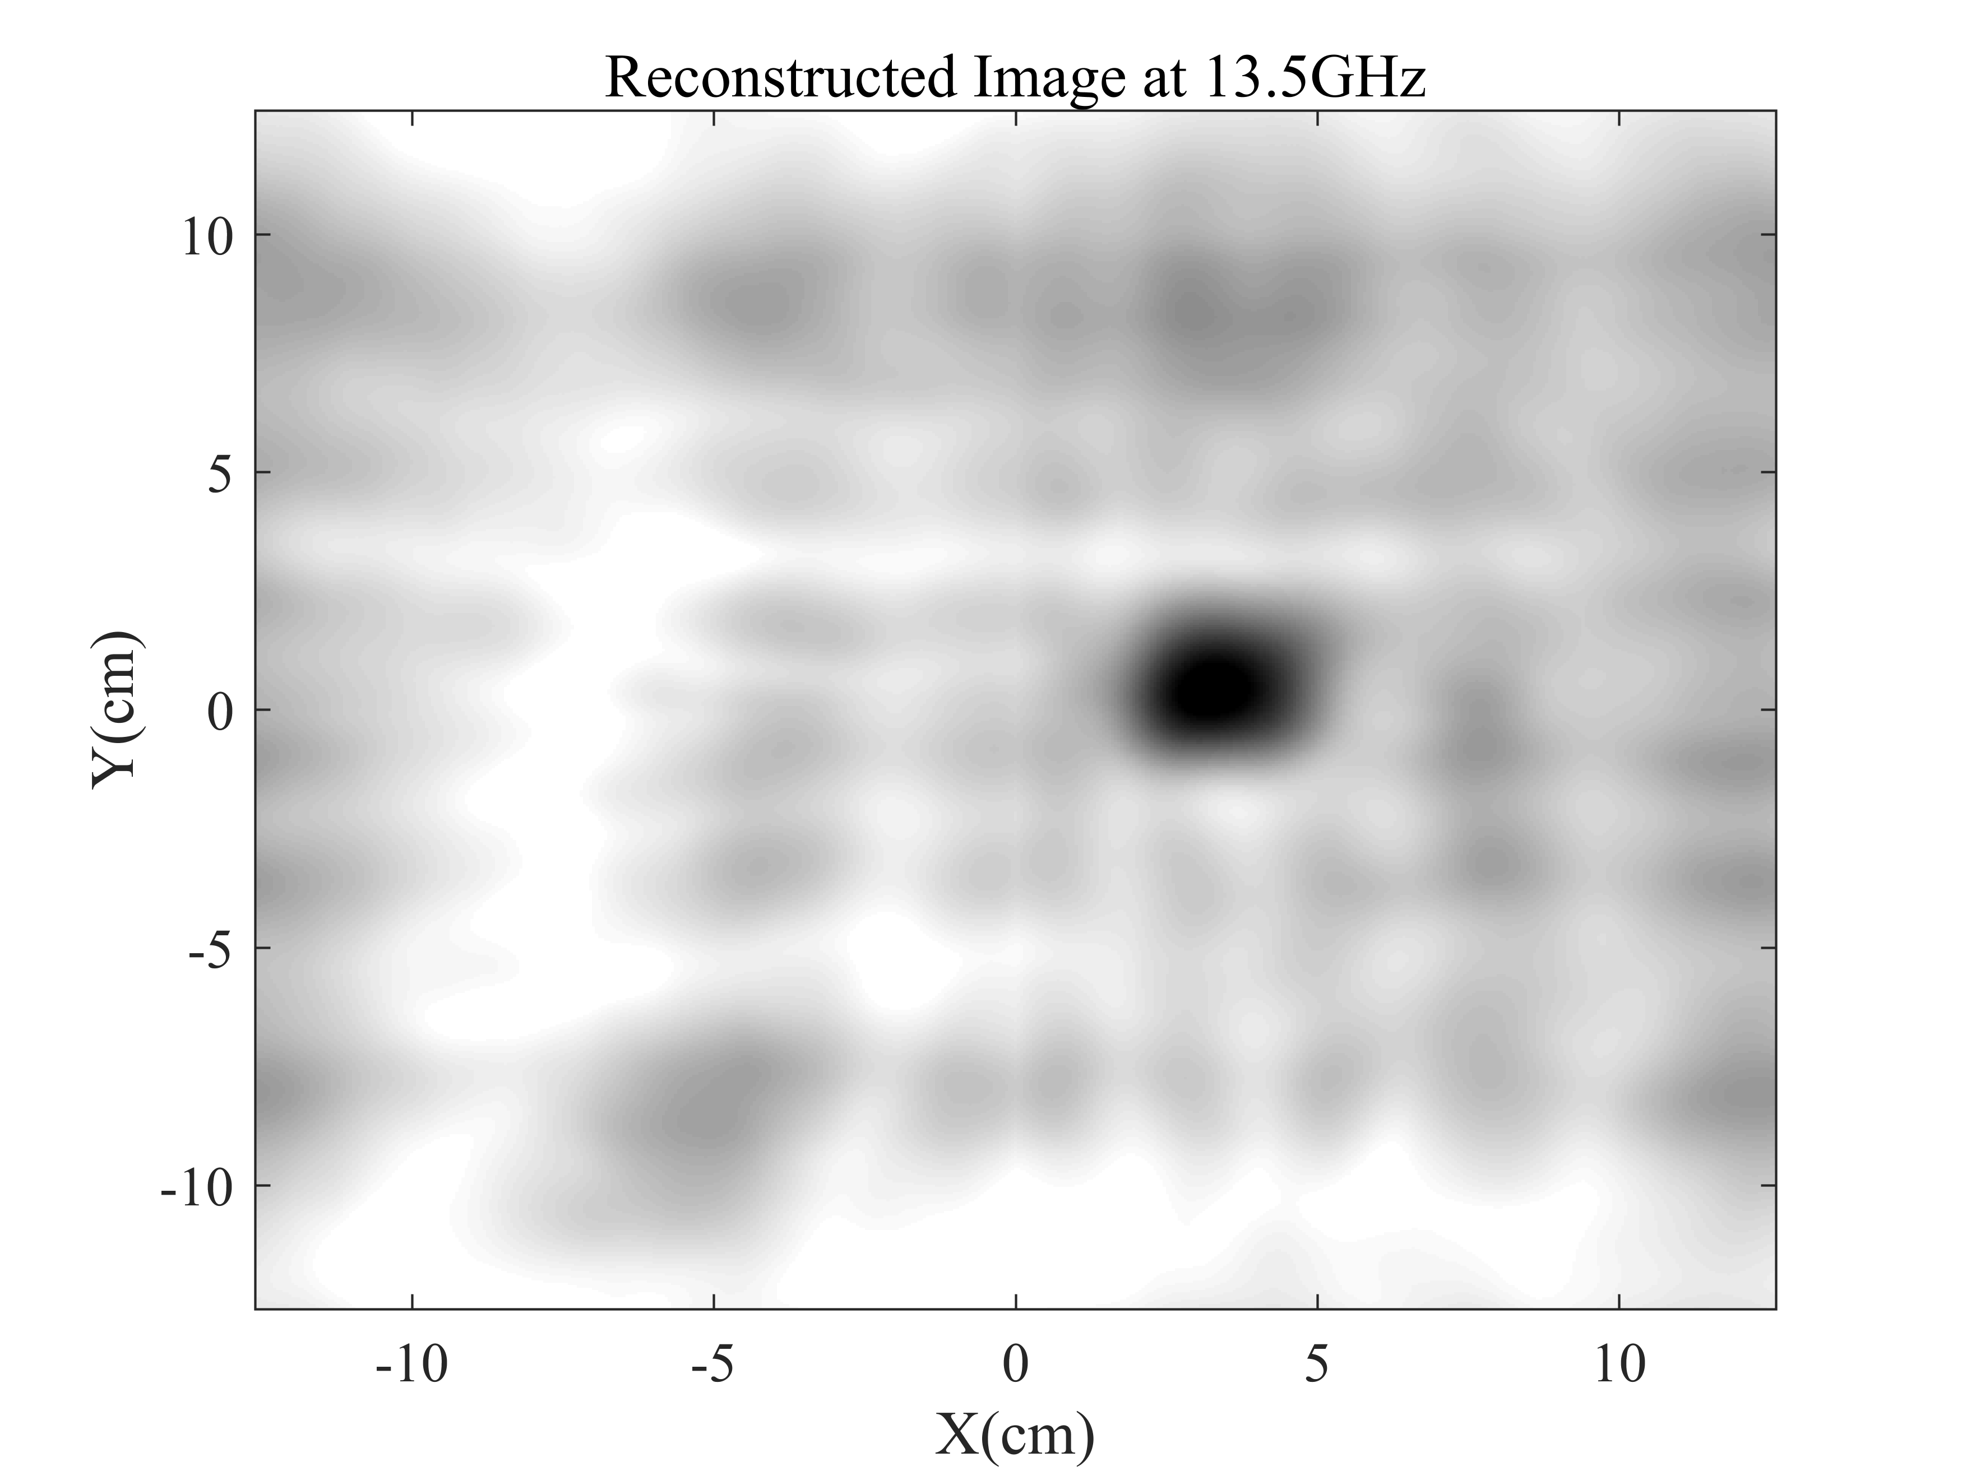
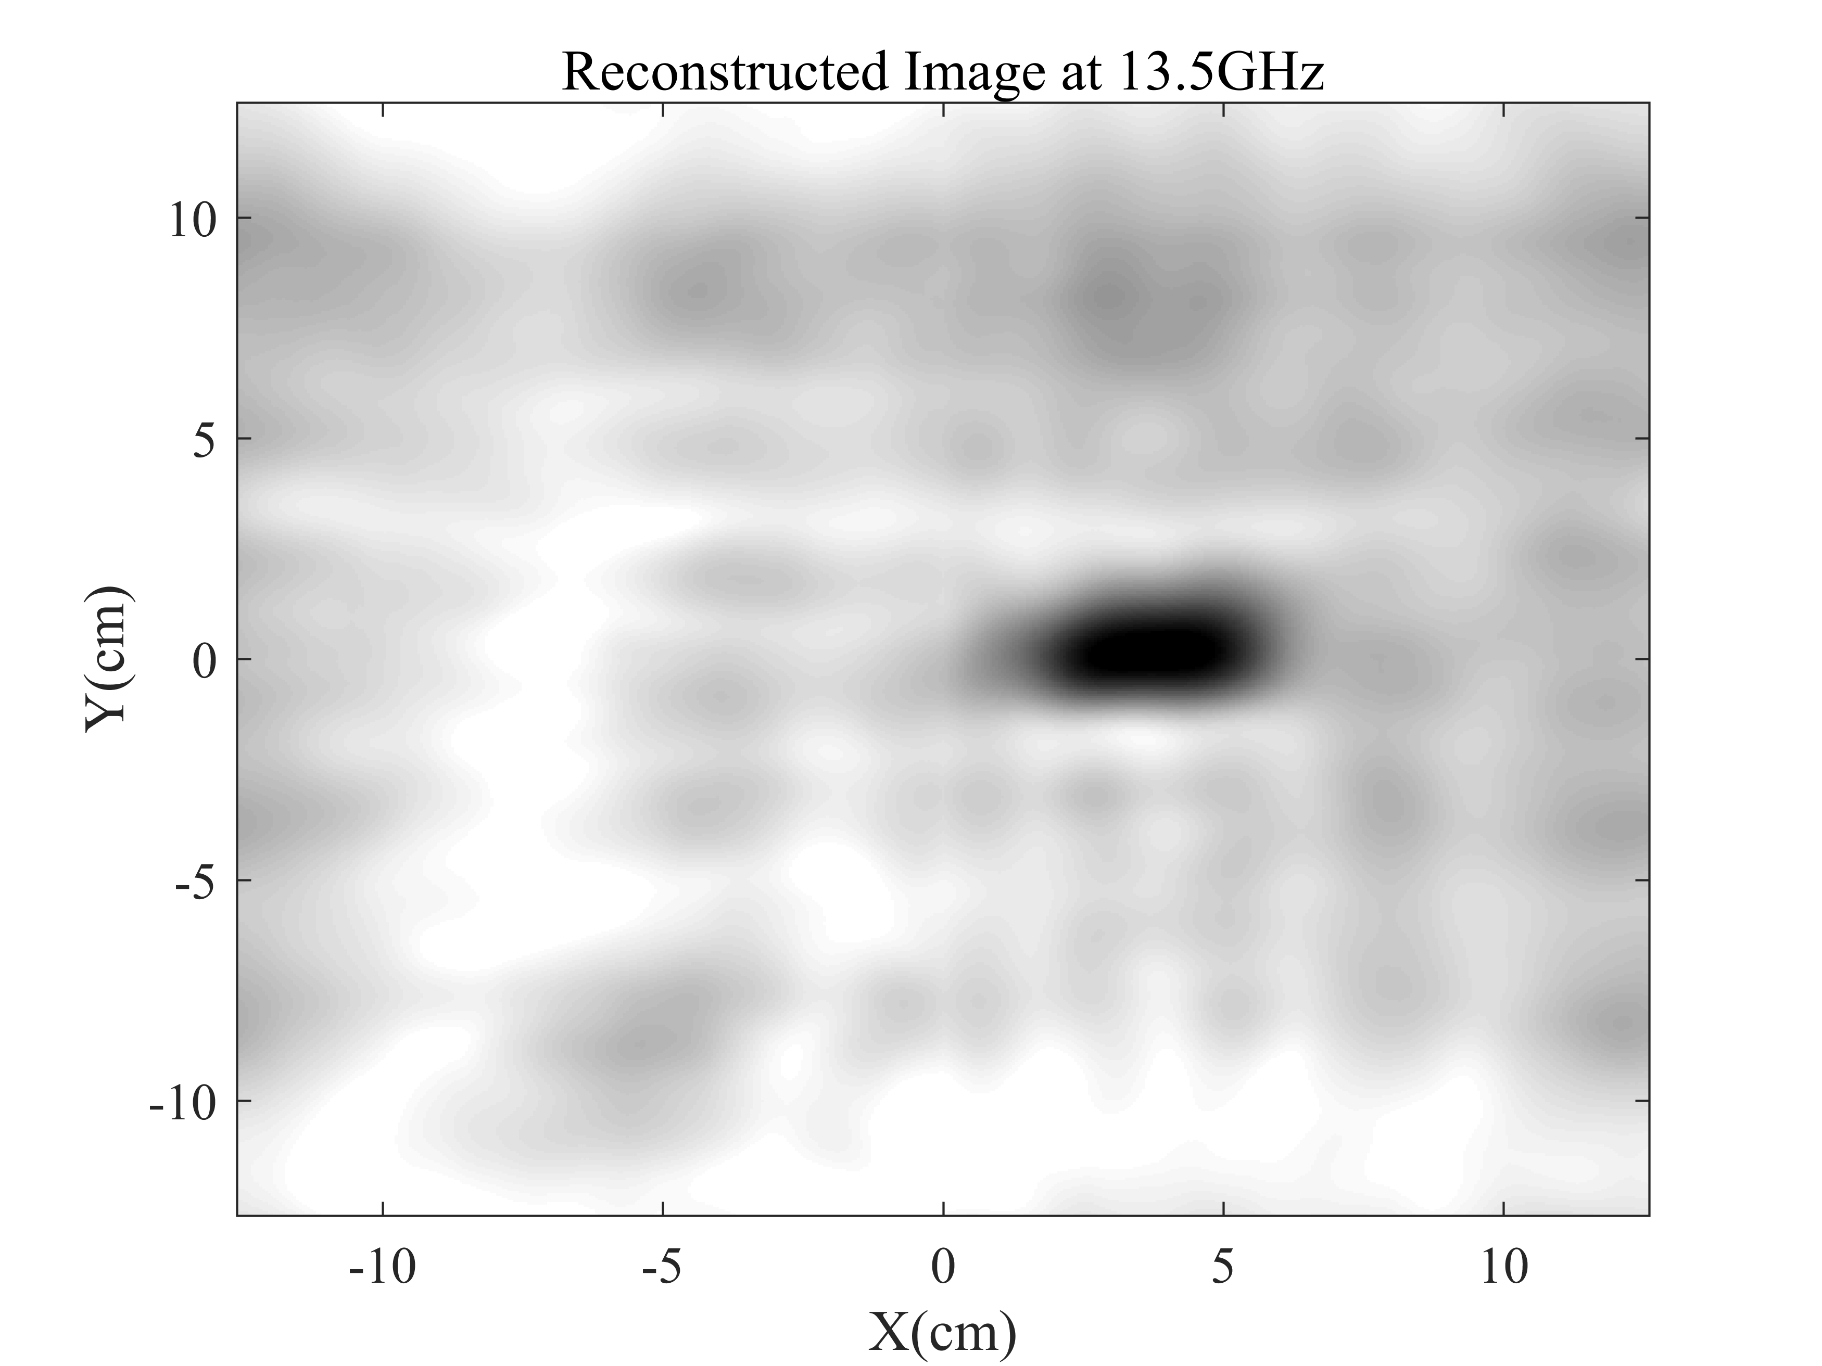
Imaging Results(3)
NaCl
KNO₃
NaNO₃

Slide 12
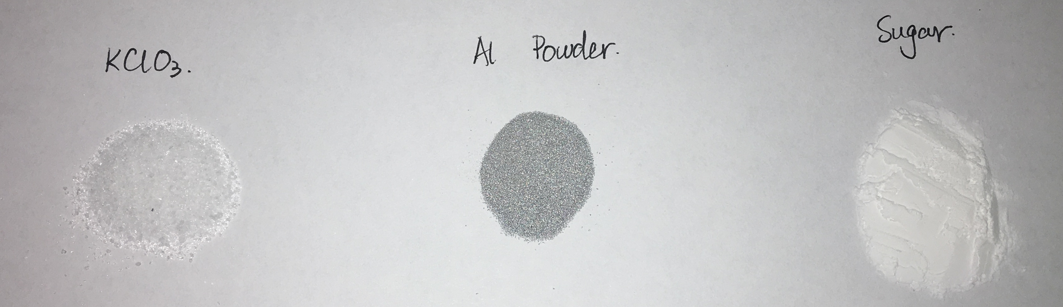
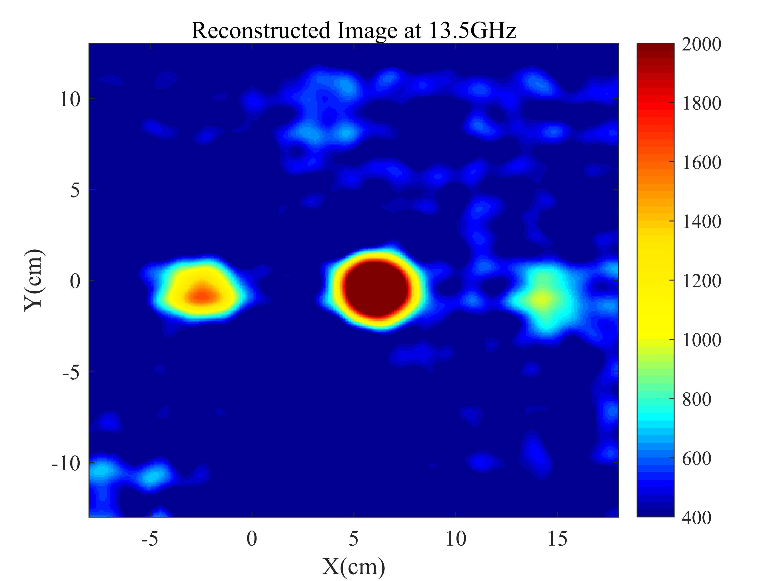
Imaging Results(4)

Slide 13
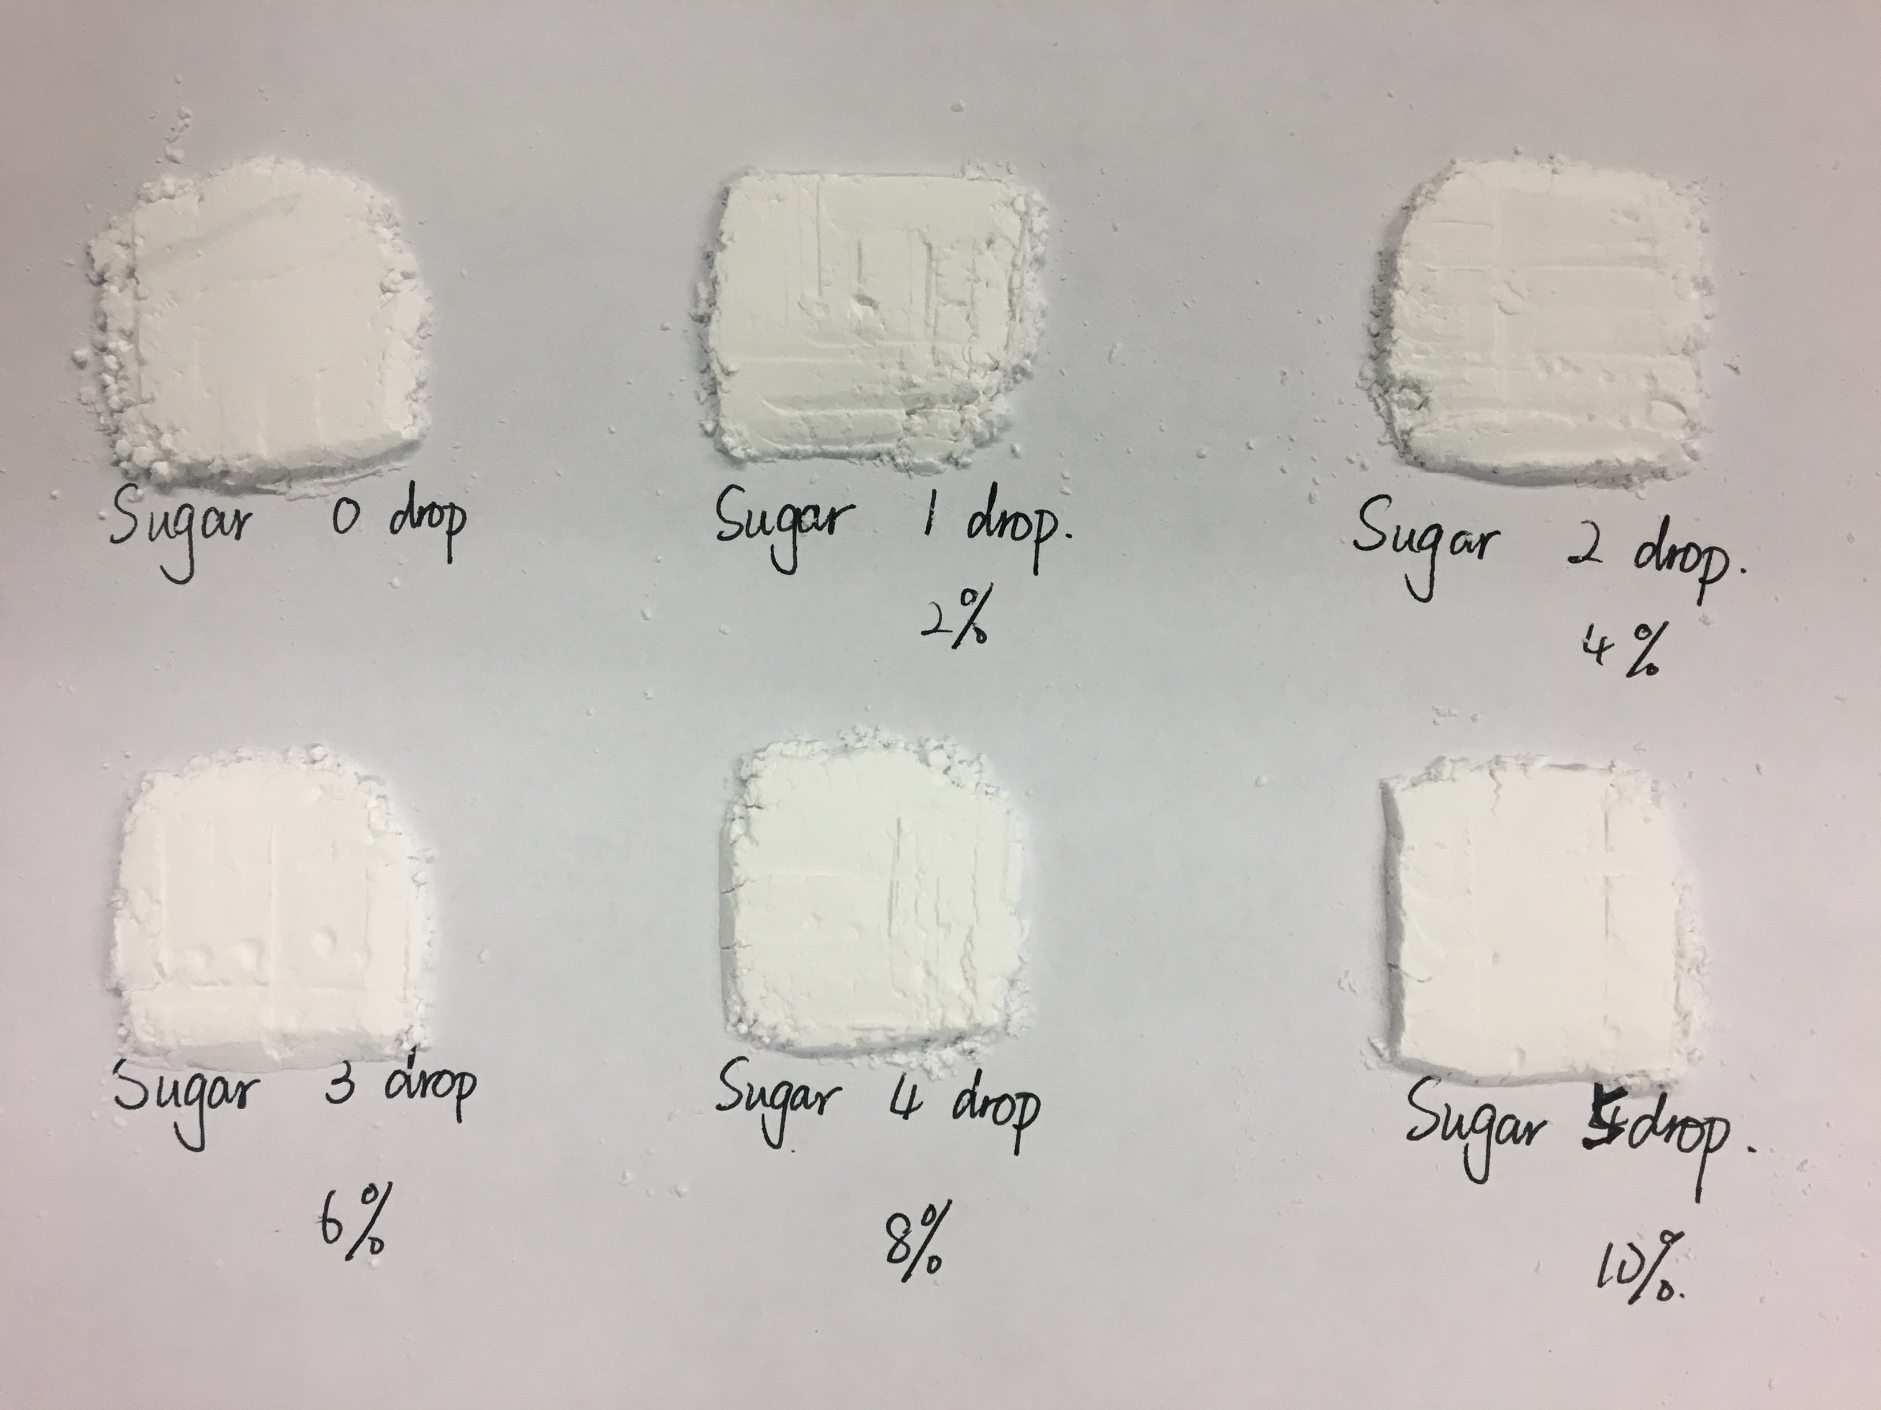
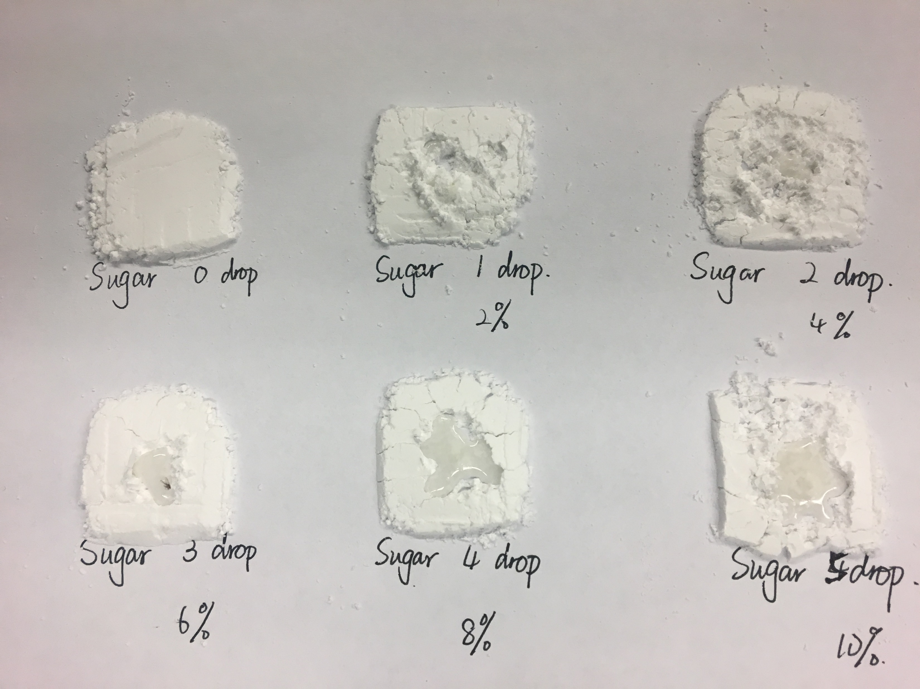
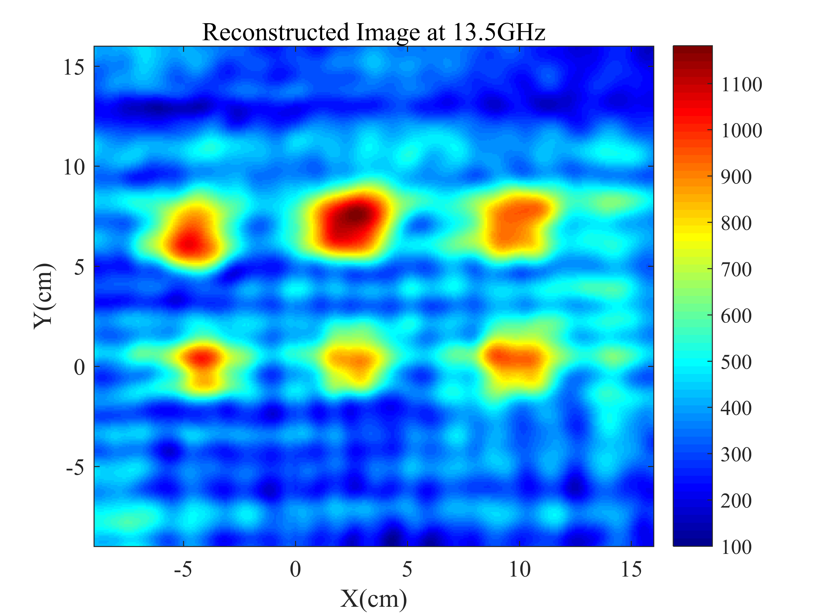
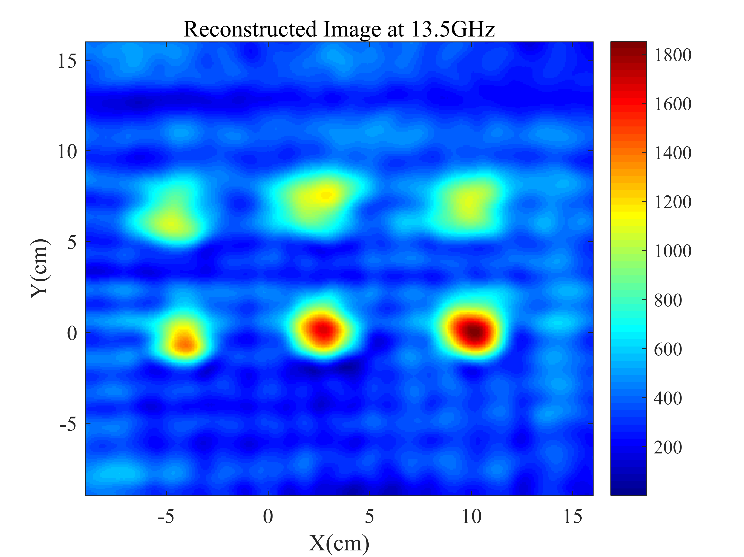
Imaging Results(5)

Slide 14
Next step
Preform imaging experiment at different height of chemical powders.
Some concerns:
Same amount, different setup

